Slide 1
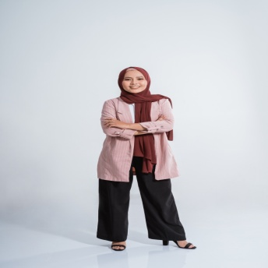
Samira Hadid
163 Woodlands Place Algies Bay, Rodney 0920
123-456-7890
hello@reallygreatsite.com
www.reallygreatsite.com
@reallygreatsite
A results-oriented Marketing Executive with 10+ years of experience in using effective marketing solutions to drive sales growth and boost client brand equity. Plans and supervises overall marketing strategy across various platforms. Specializes in project implementation and management.
Educational Background
Work Experience
Tresswood University
Wolloughdale
Master's Degree in Integrated Marketing Communications
2021
Cum Laude
Outstanding Master's Thesis Award
University of Goulcrest
Goulcrest
Bachelor's Degree in Marketing Management
2014
Magna Cum Laude
Consistent Dean's Lister
Marketing Executive
Strategea Branding
May 2018 to Present
Oversees the company's digital marketing strategies and manages day-to-day admin operations.
Social Media Manager
Blush and Bloom Cosmetics
December 2016 to May 2018
Gathered and analyzed data to products. Handled the company's official social media accounts.
Lead Digital Marketer
Reed Paper & Co.
July 2014 to November 2016
Planned and executed digital marketing strategies that raised organic website traffic by 150%.
Skills & Proficiencies
Volunteer Work & Certification
Social media marketing
Interpersonal communication skills
Fluent in Arabic and conversational in French
Digital Marketing Manager
Lily River Children's Foundation
January 2016 to August 2019
Volunteered to run the foundation's social media accounts and spearhead its digital marketing efforts.
Content and Email Marketing Certificate
Murrayfield School of Marketing
March 2015
Attended online certification course to strengthen content creation and marketing skills.
PBGRC.Org

Slide 2
Samira Hadid
163 Woodlands Place Algies Bay, Rodney 0920
www.reallygreatsite.com | hello@reallygreatsite.com
March 16, 2025
Francois Andrade
Director of Marketing
Harper and Partners Inc.
2507 Snowbird Lane
Bellevue, NE 68005
Dear Mr. Andrade,
A cover letter is a three- or four-paragraph document to an employer explaining your interest in a specific job. It’s a one-page letter that is usually attached to your resume. This letter should also highlight your fitness for the advertised role.
Writing a cover letter as a mid-career professional is a bit different. But first, start with how you found out about the career opening and why you’re interested in the job position. Be specific: use the correct names and titles.
As you write this letter, use clear and readable words. You want to come across as professional and approachable, but not overly formal.
Next, provide examples of why you’re the right person for the job.
Don’t hesitate to use bullet points and include numbers that showcase your achievements.
Rather than simply describe what you’ve done in previous jobs, show the recruiter or hiring manager what you can bring to the role.
Express your passion and excitement to be part of the company and the team.
Finally, provide your contact information and how you prefer to be reached. Offer to meet with the reader at their earliest convenience. Thank them for their time and attention, and let them know that you look forward to hearing from them soon.
Before you send your cover letter, read your draft out loud to quickly spot errors and wordy sentences. You can also ask a friend to review your cover letter. Good luck on your job search.
Yours sincerely,
Samira Hadid
PBGRC.Org

